Slide 1

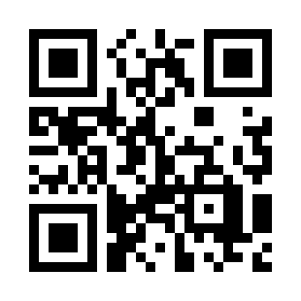

CSS Box Model and Layout (Responsive Design) Quiz
https://bit.ly/3eXCHr5

